Slide 1
PARALLEL COMPUTING
SUBJECT CODE:BCS702

Slide 2
Course Information
Total Hours of Pedagogy: 40 hours Theory + 8-10 Lab slots
Credits: 04
CIE Marks: 50
SEE Marks: 50
Total Marks: 100

Slide 3
Suggested Learning Resource Textbooks
1. Peter S Pacheco, Matthew Malensek – An Introduction to Parallel Programming, second edition, Morgan Kauffman.
2. Michael J Quinn – Parallel Programming in C with MPI and OpenMp, McGrawHill

Slide 4
Reference Books
1. Calvin Lin, Lawrence Snyder – Principles of Parallel Programming, Pearson
2. Barbara Chapman – Using OpenMP: Portable Shared Memory Parallel Programming, Scientific and Engineering Computation
3. William Gropp, Ewing Lusk – Using MPI:Portable Parallel Programing, Third edition, Scientific and Engineering Computation

Slide 5
Web links and Video Lectures (e-Resources):
1. Introduction to parallel programming: https://nptel.ac.in/courses/106102163

Slide 6
COURSE OBJECTIVES
This course will enable to,
Explore the need for parallel programming
Explain how to parallelize on MIMD systems
To demonstrate how to apply MPI library and parallelize the suitable programs
To demonstrate how to apply OpenMP pragma and directives to parallelize the suitable programs
To demonstrate how to design CUDA (Compute Unified Device Architecture))program

Slide 7
Course Outcomes
AT THE END OF THE COURSE, THE STUDENT WILL BE ABLE TO:
-EXPLAIN THE NEED FOR PARALLEL PROGRAMMING
-DEMONSTRATE PARALLELISM IN MIMD SYSTEM.
-APPLY MPI LIBRARY TO PARALLELIZE THE CODE TO SOLVE THE GIVEN PROBLEM.
-APPLY OPENMP PRAGMA AND DIRECTIVES TO PARALLELIZE THE CODE TO SOLVE THE GIVEN PROBLEM
-DESIGN A CUDA PROGRAM FOR THE GIVEN PROBLEM

Slide 8
Module 1 -syllabus
Introduction to Parallel programming, Parallel hardware and parallel
software –
Classifications of parallel computers
SIMD systems
MIMD systems
Interconnection networks
Cache coherence,
Shared-memory vs. distributed-memory
Coordinating the processes/threads
Shared-memory
Distributed-memory.

Slide 9
Evolution of Microprocessor Performance
1986–2003: Microprocessor performance improved by more than 50% per year on average.
-This rapid growth was driven by
-higher clock speeds,
- improved processor designs, and
-semiconductor technology advancements.
-During this period, most computers used SINGLE-CORE PROCESSORS.
Since 2003: The rate of improvement in SINGLE-CORE PROCESSOR performance slowed significantly because of challenges such as
-power consumption,
-heat dissipation, and
-physical limits of increasing clock speeds.
2015–2017: Single-core performance increased by less than 4% per year, making it difficult to achieve major speed improvements through faster individual processors alone.

Slide 10
Contd..
By 2005: Most major microprocessor manufacturers shifted their focus to parallelism.
Instead of building ever-faster single-core processors, they began designing multi-core processors, placing multiple complete processing cores on a single integrated circuit (chip).
Result: Multi-core processors allow multitasking and parallel execution of programs, improving overall system performance and enabling applications to perform multiple operations simultaneously.

Slide 11
Effect of Multi-Core Processors on Software
The shift to multi-core processors created a major challenge for software developers.
Simply adding more processors (cores) does not automatically make existing programs run faster.
Most older programs are serial programs, meaning they were designed to execute one instruction at a time on a single processor.
These programs are not aware of multiple processors, so they cannot divide their work among different cores.
As a result, when a serial program runs on a multi-core system, it usually uses only one core, while the other cores remain idle.
Therefore, the program's performance on a multi-core processor is almost the same as its performance on a single-core processor (assuming the cores have similar speed).

Slide 12
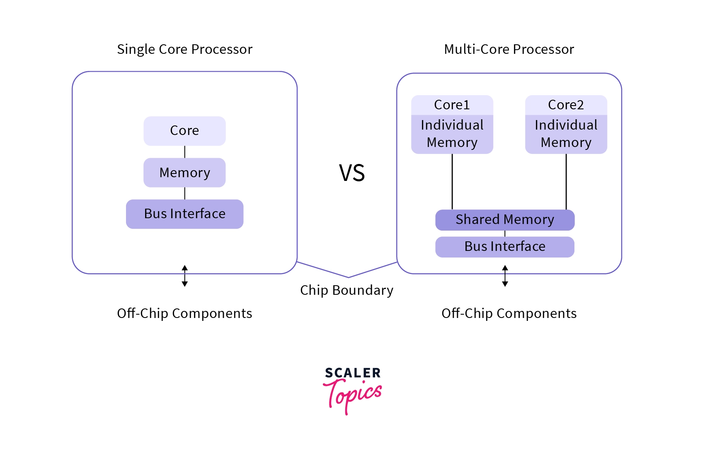
Diagram for single and Multi-core processor

Slide 13
Key point
To take advantage of multiple processors, software must be written or redesigned as a parallel program, where the work is divided into multiple tasks that can run simultaneously on different cores.
Example
Serial Program: One person writes 100 pages alone → takes 100 hours.
Parallel Program: Four people each write 25 pages at the same time → finishes much faster (about 25 hours).
Conclusion: Multi-core processors improve performance only if the software is designed for parallel execution. Otherwise, adding more cores provides little or no speed improvement.

Slide 14
Importance of Increased Computational Power -Key Contributions
Human Genome Decoding: Faster computers made it possible to sequence and analyze the human genome in a practical amount of time.
Medical Imaging: Improved computing enables more accurate and detailed imaging techniques such as CT scans and MRI, helping doctors diagnose diseases more effectively.
Web Search: Search engines can process billions of web pages and return highly accurate results within seconds.
Computer Games: Modern games feature realistic graphics, advanced physics, and intelligent AI due to increased processing power.

Slide 15
Other Important Applications
Climate Modeling: Simulating Earth's climate to predict weather patterns and study climate change.
Protein Folding: Understanding how proteins fold, which is essential for studying diseases and developing new medicines.
Drug Discovery: Accelerating the identification and testing of potential drugs using computer simulations.
Energy Research: Designing efficient energy systems, improving batteries, and simulating nuclear fusion and renewable energy technologies.
Data Analysis: Processing and analyzing massive datasets in fields such as business, finance, healthcare, and artificial intelligence.

Slide 16
The huge improvement in the performance of single-processor computers was mainly due to the increasing number of transistors (tiny electronic switches) that could be placed on a single integrated circuit (chip).
As transistors became smaller, they could:
Switch faster, making the processor run at higher speeds.
Allow more transistors to fit on the same chip
Increasing computing power.
However,
- Faster transistors consume more electrical power.
- Most of this electrical power is converted into heat.
- If the processor chip becomes too hot,
it can:
-Produce errors,
-Become unstable, Or
-even fail to work reliably.

Slide 17
In short
Smaller transistors → More transistors + Faster processors → Better performance
But Faster processors → Higher power consumption → More heat
Too much heat → Reduced reliability of the processor

Slide 18
Contd..
Because increasing the speed of a single processor creates too much heat and consumes too much power, computer designers use parallelism.
Parallelism means performing multiple tasks at the same time instead of making one processor do everything faster.
Instead of designing one very fast and complicated processor, manufacturers place multiple processors (called cores) on a single chip.
Each core is a complete CPU (Central Processing Unit) that can execute instructions independently.
Since, several cores work simultaneously, the computer can perform more work in the same amount of time.
These chips are called multicore processors.

Slide 19
TERMINOLOGIES
Parallelism: Executing multiple tasks simultaneously.
Core: An individual CPU inside a processor chip.
Multicore Processor: A processor containing two or more CPU cores on one chip.
Single-Core System: A traditional processor with only one CPU/core.

Slide 20
Why we need to write parallel programs
1.Rewrite serial programs as parallel programs
A serial program executes one instruction after another using a single core.
A parallel program divides the work into multiple tasks that can run simultaneously on different cores.
This allows the program to make full use of multicore processors, resulting in faster execution.
Example
Serial: One worker completes 100 tasks one by one.
Parallel: Four workers each complete 25 tasks at the same time.

Slide 21
2.Use translation programs (Automatic parallelization)
Instead of manually rewriting existing serial programs, we can use translation programs (parallelizing compilers or tools).
These programs automatically analyze a serial program and convert suitable parts into parallel code.
This saves programmer effort, although automatic translation is difficult because the tool must determine which instructions can safely execute simultaneously.

Slide 22
Why do we need parallel programs?
To utilize multiple CPU cores effectively.
To improve program performance and reduce execution time.
To overcome the limits of increasing single-core processor speed.
To reduce power consumption and heat compared to simply increasing clock speed.

Slide 23
Example
suppose that we need to compute n values and add them together.
serial code:
sum = 0;
for ( i = 0; i < n ; i ++) {
x = Compute_next_value ( . . . ) ;
sum += x ;
}

Slide 24
Single core
my_sum = 0;
my_first_i = . . . ;
my_last_i = . . . ;
for ( my_i = my_first_i ; my_i < my_last_i ; my_i ++) {
my_x = Compute_next_value ( . . . ) ;
my_sum += my_x ;
}

Slide 25
Multiple Core
values stored in my_sum might be
Core 0 1 2 3 4 5 6 7
my_sum 8 19 7 15 7 13 12 14
we’re assuming the cores are identified by nonnegative integers in the range 0, 1, . . . , p −1, where p is the number of cores.

Slide 26
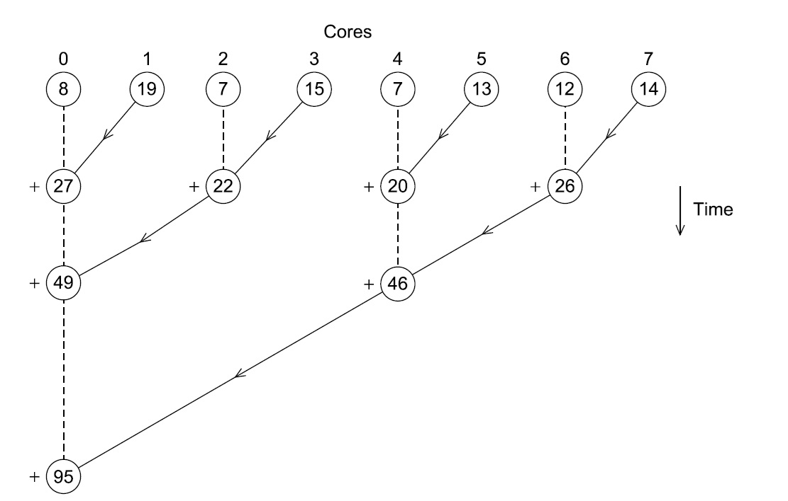
Multiple cores forming a global sum.
Parallel reduction (tree reduction), a common technique used in parallel computing
CUDA -Compute Unified Device Architecture,
OpenMP- Open Multi-Processing,
MPI- Message Passing Interface,
GPU - Graphics Processing Unit to compute the global sum of values distributed across multiple cores.

Slide 27
Core0 = 8
Core1 = 19
Core2 = 7
Core3 = 15
Core4 = 7
Core5 = 13
Core6 = 12
Core7 = 14

Slide 28
Core0 = 8
Core1 = 19
Core2 = 7
Core3 = 15
Core4 = 7
Core5 = 13
Core6 = 12
Core7 = 14

Slide 29
Step 2: First Reduction Stage (Pairwise Addition)
Each pair of neighboring cores performs an addition.
Arrows indicate that one core sends its value to another core, which performs the addition.
Pair 1
Core1 sends 19 to Core0.
Core0 = 8 + 19 = 27
Pair 2
Core3 sends 15 to Core2.
Core2 = 7 + 15 = 22

Slide 30
Pair 3
Core5 sends 13 to Core4.

Slide 31
How do we do parallelism
Depend on the basic idea of partitioning the work to be done among the cores.
There are two widely used approaches:
Task-parallelism
Data-parallelism.
In task-parallelism, we partition the various tasks carried out in solving the problem among the cores.
In data-parallelism, we partition the data used in solving the problem among the cores, and each core carries out more or less similar operations on its part of the data.

Slide 32
What we do in course?
Our purpose is to learn the basics of programming parallel computers using the C language
Four different APIs or application program interfaces: the Message-Passing Interface or MPI, POSIX threads or Pthreads, OpenMP, and CUDA(Compute Unified Device Architecture).
MPI: Uses multiple processes with message passing; ideal for distributed-memory systems and supercomputers.
Pthreads: Uses multiple threads in a shared-memory process; offers fine-grained control but requires manual synchronization.
OpenMP: Uses compiler directives to automatically create and manage threads for shared-memory multicore CPUs.
CUDA: Uses GPU cores to execute thousands of threads in parallel, making it well suited for AI, graphics, and other compute-intensive applications.

Slide 33
Parallel Computing
Parallel computing is a type of computation in which many calculations or processes are carried out simultaneously

Slide 34
What is Parallel Computing?
What is Parallel Computing?
Parallel Computing is a computing technique in which multiple processors or multiple CPU cores work together simultaneously to solve a single problem. Instead of executing one instruction at a time,
the problem is divided into smaller independent tasks, and each task is executed concurrently by different processors.
This significantly reduces the total execution time and improves system performance.
Definition-
Parallel Computing is the process of performing multiple computations or executing multiple instructions simultaneously by using two or more processors or cores to solve a computational problem faster.

Slide 35
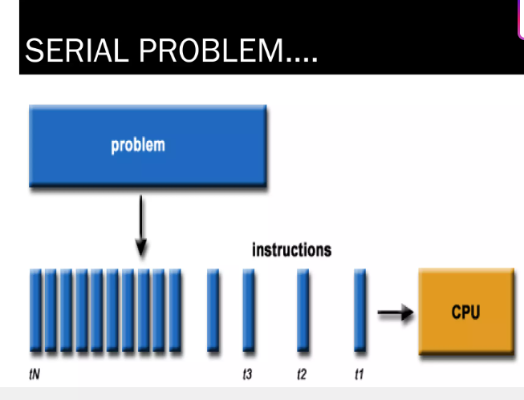
Serial Computing

Slide 36
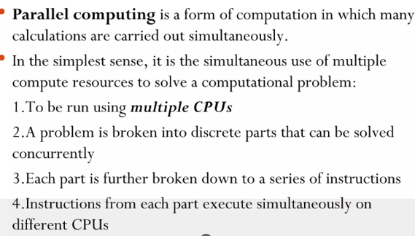
Parallel Computing

Slide 37
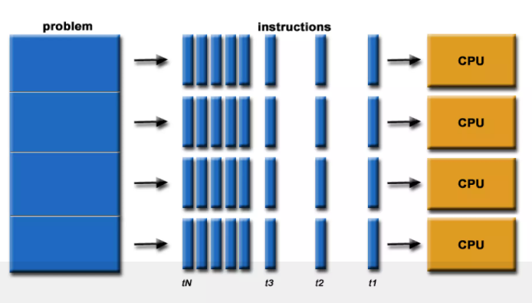
Parallel Computing

Slide 38
USE OF PARALLEL COMPUTING?
Parallel computing is used to solve problems faster and more efficiently by doing many tasks simultaneously.
1. Speed up Execution
2. Solve Bigger Problems
3. Efficient Resource Use
4. Real-Time Processing
5. Energy Efficiency
6. Scalability
7. Enables Complex Simulations
1.Speed up Execution
Main benefit: Tasks run faster by splitting them across multiple processors.
Example: A simulation that takes 10 hours on one CPU might take 1 hour on 10 CPUs.

Slide 39
USE OF PARALLEL COMPUTING?
2. Solve Bigger Problems
Some problems are too large for a single machine to handle (e.g., climate models, DNA sequencing).
Parallel systems can process massive datasets by dividing the load.
3. Efficient Resource Use
Multi-core CPUs, GPUs, and cloud resources are common and affordable.
Parallel computing makes full use of available hardware.

Slide 40
WHY USE OF PARALLEL COMPUTING?
4.Real-Time Processing
Needed in areas like medical imaging, robotics, or self-driving cars, where quick decisions are vital.
Parallelism ensures results are available in real time.
5. Energy Efficiency
Instead of overloading one processor, tasks can be shared across many, reducing heat and power consumption per task.

Slide 41
WHY USE OF PARALLEL COMPUTING?
6.Scalability
As data grows (big data, AI, etc.), parallel computing can scale with demand by adding more processors or nodes.
7. Enables Complex Simulations
Physics, chemistry, biology, and finance simulations often need high computational power.
Parallel computing enables these simulations to run efficiently.

Slide 42
Characteristics of Parallel Computing
A problem is divided into multiple smaller sub-problems.
Each sub-problem is assigned to a different processor or CPU core.
Multiple instructions are executed simultaneously.
Processors communicate and synchronize when required.
The partial results are combined to produce the final output.
It improves execution speed, efficiency, and resource utilization.
Working of Parallel Computing
The main problem is split into smaller tasks.
Each processor or core executes its assigned task at the same time.
After completing their tasks, the processors combine their results.
The combined result forms the final solution.

Slide 43
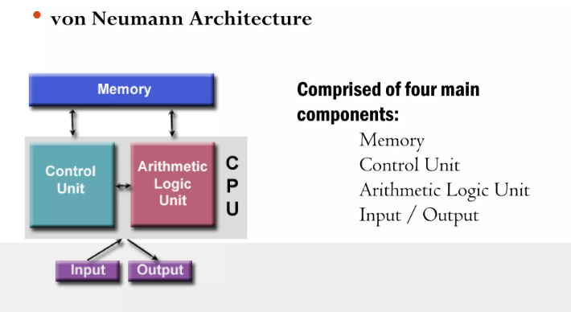
ARCHITECTURE CONCEPTS

Slide 44
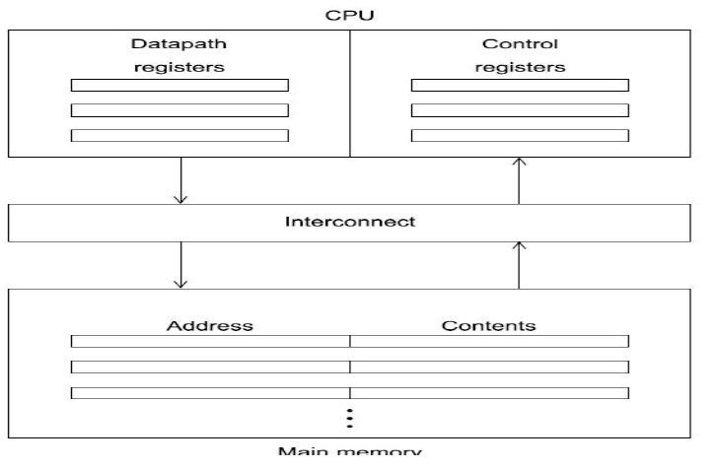
The von Neumann architecture
The “classical” von Neumann architecture consists of
main memory,
a central processing unit (CPU) or processor or core,
and an interconnection between the memory and the CPU.

Slide 45
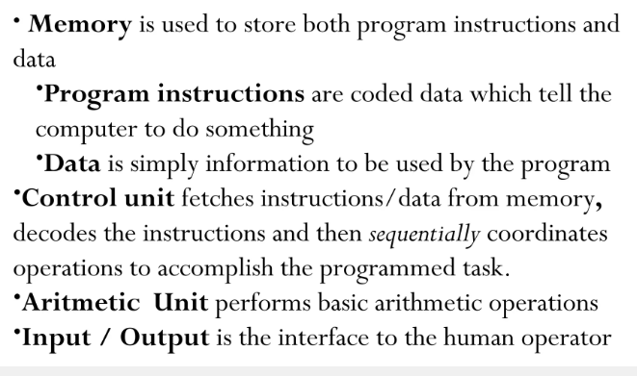
ARCHITECTURE CONCEPTS CONTD..

Slide 46
Parallel Hardware
Parallel hardware refers to the physical components (processors, memory, interconnects) that enable parallel computing by allowing multiple operations to occur at the same time.
1. Multi-Core Processors
2. Graphics Processing Units (GPUs)
3. Multiprocessor Systems
4. Clusters
5. Supercomputers
6. Field-Programmable Gate Arrays (FPGAs)
7. Interconnects
1. Multi-Core Processors
A single chip with multiple cores (CPUs).
Each core can execute tasks independently.
Example: Quad-core or Octa-core CPUs in laptops and phones.

Slide 47
2. Graphics Processing Units (GPUs)
Thousands of smaller cores designed for parallel data processing.
Ideal for tasks like image processing, machine learning, and simulations.
Example: NVIDIA CUDA-enabled GPUs.

Slide 48
3. Multiprocessor Systems
Multiple CPUs in one system.
Each processor can work on a separate task or collaborate on one large task.
Example: Dual-processor servers.

Slide 49
4. Clusters
A group of networked computers (nodes) working together on a problem.
Each node runs part of the program.
Used in scientific computing and data centers.

Slide 50
5. Supercomputers
Extremely powerful systems made up of thousands of processors or nodes.
Used for weather forecasting, nuclear simulations, AI research, etc.

Slide 51
6. Field-Programmable Gate Arrays (FPGAs)
Hardware that can be programmed after manufacturing to execute specific parallel tasks efficiently.
Used in signal processing, AI inference, and hardware acceleration.

Slide 52
Parallel Hardware
7. Interconnects
Fast communication hardware like InfiniBand or Ethernet used in clusters and supercomputers.
Interconnects are communication links that connect processors, memory, and storage devices.
Helps in data transfer between parallel nodes.
Type | Function
Bus | Transfers data between components
Ring | Connects components in a circular form
Mesh | Provides multiple communication paths
Hypercube | Used in supercomputers

Slide 53
Parallel Software
Parallel software is designed to run tasks simultaneously using multiple processing units (CPUs, cores, or GPUs).
It includes languages, libraries, and frameworks that help developers write efficient parallel code.
  1. Parallel Programming Languages
  2. Parallel Programming Models
  3. Popular Parallel Libraries & Tools
  4. Operating System Support
  5. Debugging and Performance Tools

Slide 54
1.Parallel Programming Languages
These languages have built-in support for parallelism:
C/C++ with OpenMP: Adds simple directives to enable multi-threading.
Fortran with OpenMP: Used in scientific computing.
Python (with libraries like multiprocessing, concurrent.futures, or Dask).
Java (via Thread, Executor Service, or parallel streams).

Slide 55
2. Parallel Programming Models
These define how tasks are split and managed:
1. Thread-based (Shared Memory): Tasks (threads) run in the same memory space.
2. Message Passing (Distributed Memory): Each task has separate memory and communicates via messages (e.g., MPI).
3. Data Parallelism: Same operation on different parts of data.
4. Task Parallelism: Different tasks running simultaneously.

Slide 56
3.Popular Parallel Libraries & Tools
Tool/Library | Use Case | Platform
OpenMP | Multi-threading in C/C++/Fortran | Shared memory systems
MPI (Message Passing Interface) | Parallel programs on clusters | Distributed memory
CUDA | GPU programming (NVIDIA) | High-performance computing
OpenCL | Cross-platform GPU/CPU programming | Heterogeneous systems
Dask | Parallel computing in Python | Big data workloads
TensorFlow & PyTorch | Deep learning on GPUs/TPUs | AI/ML
Apache Spark | Distributed data processing | Big data platforms

Slide 57
Parallel Software
4. Operating System Support
Modern OSes like Linux, Windows, and macOS support multi-threading, process scheduling, and resource management for parallel software.
5. Debugging and Performance Tools
GDB / Valgrind – Debugging parallel C/C++ code.
Intel VTune, NVIDIA Nsight, or Perf – Performance profiling.
Visual Studio – Parallel debugging support for C#/C++.

Slide 58
CLASSIFICATION OF PARALLEL COMPUTERS
BASED ON INSTRUCTION AND DATA STREAM
1. SISD (Single Instruction stream, Single Data stream)
Traditional sequential computers (e.g., uniprocessor systems).
2. SIMD (Single Instruction stream, Multiple Data streams)
Executes the same instruction on multiple data points simultaneously (e.g., GPUs, vector processors).
3. MISD (Multiple Instruction streams, Single Data stream)
Rare in practice; used in fault-tolerant systems or pipeline processing.
4. MIMD (Multiple Instruction streams, Multiple Data streams)
Most general form; multiple processors independently execute different instructions on different data (e.g., multicore CPUs, clusters).

Slide 59
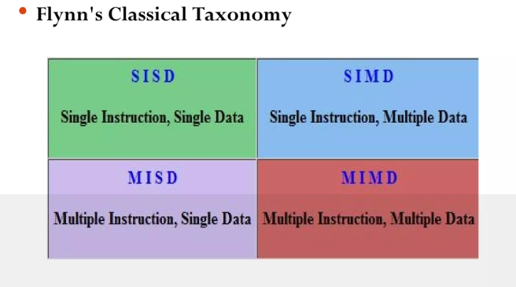
ARCHITECTURE CONCEPTS CONTD..

Slide 60
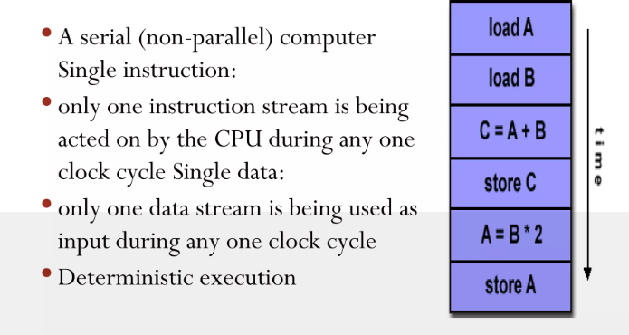
SINGLE INSTRUCTION, SINGLE DATA(SISD)

Slide 61
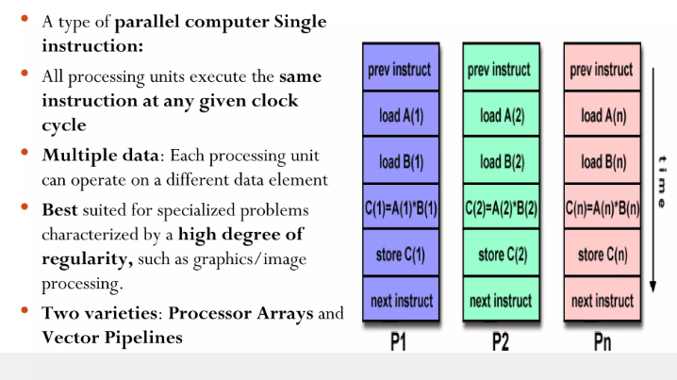
SINGLE INSTRUCTION, MULTIPLE DATA(SIMD)

Slide 62
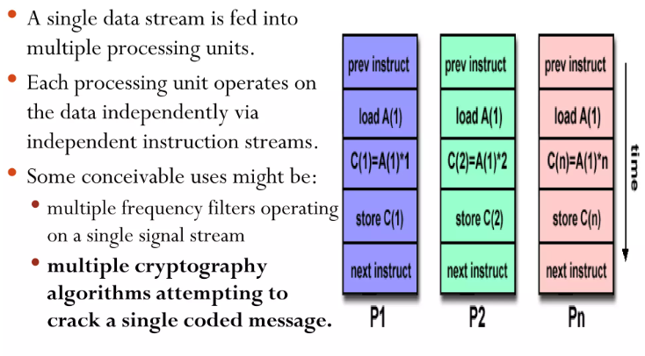
MULTIPLE INSTRUCTION,SINGLE DATA(MISD)

Slide 63
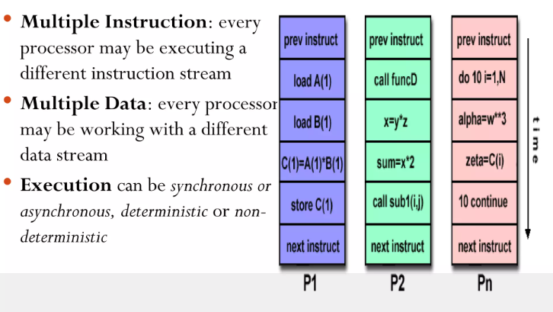
MULTIPLE INSTRUCTION, MUTIPLE DATA-MIMD

Slide 64
SIMD SYSTEMS
SIMD Systems (Single Instruction, Multiple Data)
SIMD is a type of computer architecture used in parallel processing, where a single instruction is executed on multiple data points simultaneously.
It is a key concept in parallel computing and high-performance computing (HPC), particularly useful in applications like image processing, multimedia, scientific simulations, and machine learning.

Slide 65
SIMD (Single Instruction, Multiple Data)
SIMD (Single Instruction, Multiple Data) is a parallel computing model that allows multiple processing elements to perform the same operation on multiple data points at once.
Example: If you want to add two arrays of numbers element-wise, a SIMD system can add multiple pairs at once instead of one at a time.
Key Components
Control Unit (CU) – Fetches and decodes the single instruction.
Multiple Processing Elements (PEs) – Perform operations on different pieces of data in parallel.
Memory Unit – Supplies data to PEs and stores the results.

Slide 66
Real-World Examples- SIMD
GPUs (Graphics Processing Units) – Perform the same operation (e.g., color transformation) on thousands of pixels simultaneously.
Intel SSE/AVX Instructions – Used in modern CPUs to process multiple data with a single instruction.
Neural Network Accelerators – SIMD principles help in matrix multiplications for training/inference.

Slide 67
SIMD-Applications
Image and video processing
Audio signal processing
Scientific computing
Machine learning (inference and training)
Cryptography

Slide 68
MIMD SYSTEMS
MIMD Systems (Multiple Instruction, Multiple Data)
MIMD is a powerful computer architecture model used in parallel computing where multiple processors execute different instructions on different data sets simultaneously.
It represents the most flexible and general-purpose form of parallelism.

Slide 69
Key Components
Multiple Processors – Each with its own control unit.
Independent Instruction Streams – Each processor fetches and executes its own code.
Separate or Shared Memory – May use a common memory (shared-memory systems) or local memory (distributed-memory systems).
Interconnection Network – Connects processors to memory and/or each other.

Slide 70
Shared Memory interconnect
shared memory systems to use a bus to connect processors and memory.
Buses have the virtue of low cost and flexibility as the size of shared-memory systems has increased, buses are being replaced by switched interconnects.
Switched interconnects use switches to control the routing of data among the connected devices.
A crossbar is a relatively simple and powerful switched interconnect

Slide 71
Contd..
Crossbars allow simultaneous communication among different devices, so they are much faster than buses.
However, the cost of the switches and links is relatively high.
A small bus-based system will be much less expensive than a crossbar-based system of the same size.

Slide 72
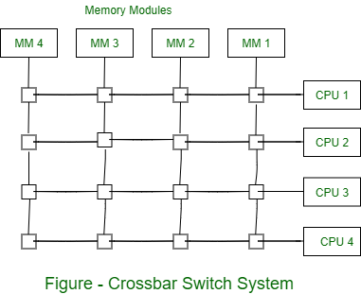
Cross Bar interconnect System

Slide 73
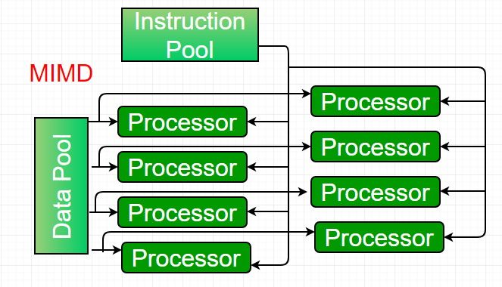
MIMD Architectures
MIMD (Multiple Instruction, Multiple Data) is a parallel computing architecture where multiple independent processors simultaneously execute different instructions on different data sets.
It enables
  true multitasking,
  high-concurrency processing,
  commonly implemented in modern multicore CPUs,
  server farms, and
  distributed cloud computing systems.

Slide 74
Types of MIMD Architectures
MIMD systems are primarily categorized into two memory models:
Shared Memory (Tightly Coupled):
All processors share a single global memory space.
Coordination happens through shared variables, making it easy to program but harder to scale.
Distributed Memory (Loosely Coupled):
Each processor has its own private memory and communicates with others via message passing.
This allows for massive scalability but increases programming complexity.

Slide 75
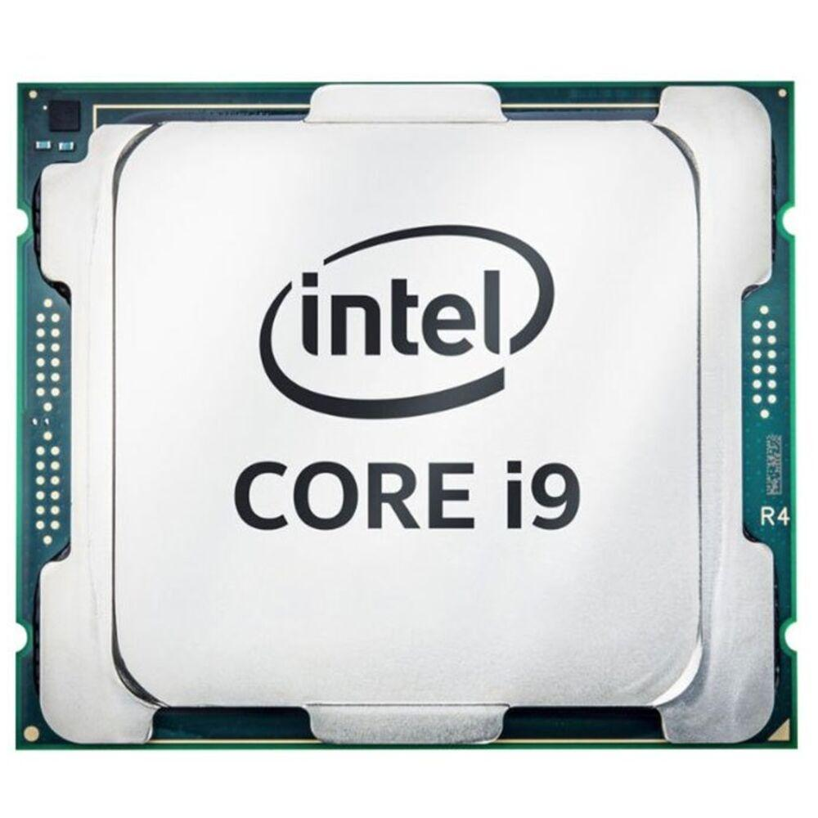
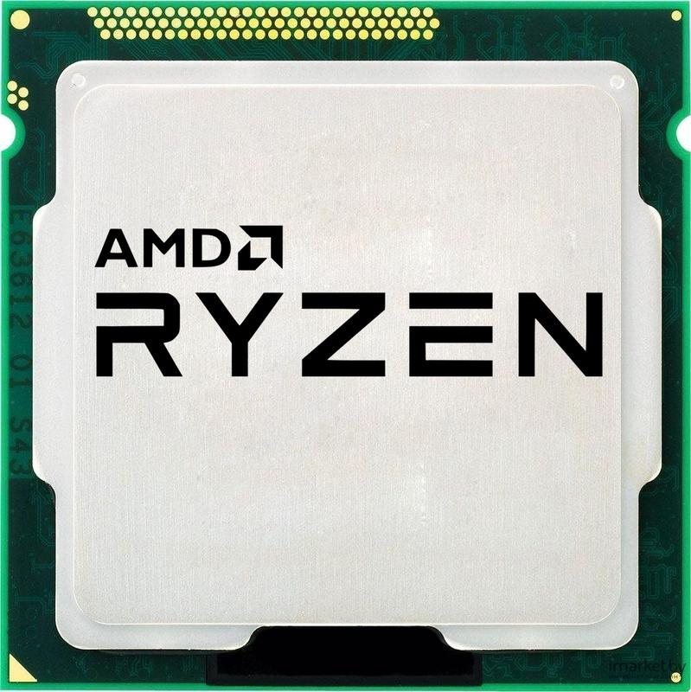
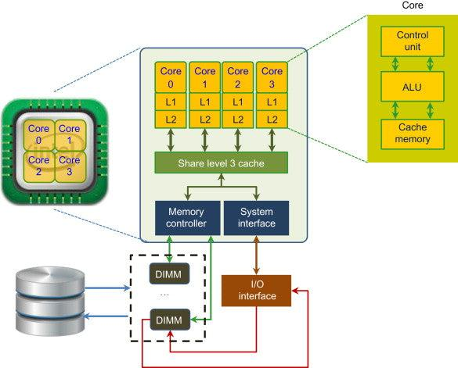
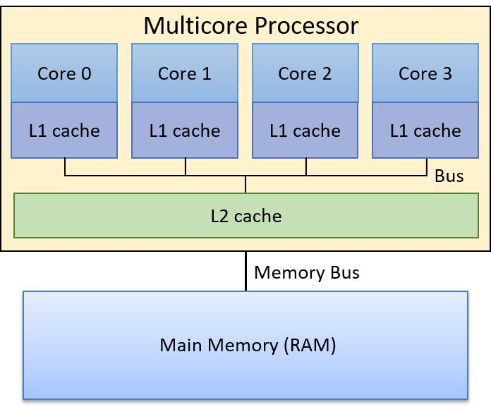
Real-World Examples
Multi-core CPUs (e.g., Intel Core i9, AMD Ryzen)
Clusters and Supercomputers
(e.g., IBM Blue Gene, Cray)
Cloud computing platforms
(e.g., AWS EC2 instances running parallel tasks)
Parallel databases

Slide 76
Interconnection Networks in Parallel Systems
Interconnection networks are the backbone of parallel computer architectures — they define how processors, memory units, and other components communicate and exchange data with each other.
In MIMD or SIMD systems, interconnection networks play a critical role in performance, scalability, and efficiency.

Slide 77
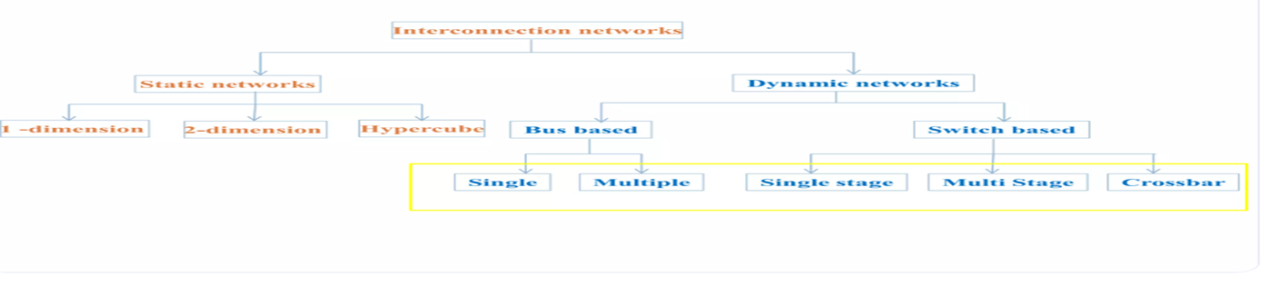

Slide 78
Purpose of Interconnection Networks
Facilitate data transfer between processors and memory modules.
Enable synchronization and coordination among processing units.
Provide a path for message passing or memory access.
The interconnect plays a decisive role in the performance of both distributed- and shared-memory systems
the processors and memory have virtually unlimited performance
If processors take too much time to exchange data with one another, the whole program becomes slow, even if the processors themselves are very fast.
Examples of Interconnection networks: Bus
Example:
Imagine four people working together on a project. If they spend more time talking and sharing information than actually working, the project will take longer to finish.
The same thing happens in parallel computing. A slow interconnect creates a communication bottleneck, which reduces the overall performance of the system.

Slide 79
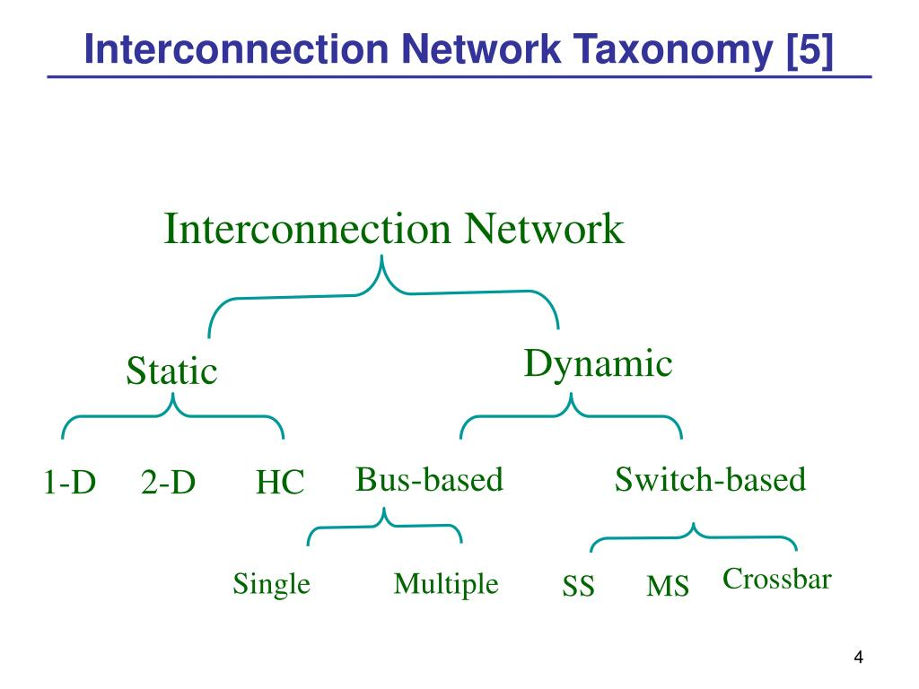
Types of Interconnection Networks
1. Static (Deterministic / Direct) networks-connections are fixed and follow specific pattern
TYPES:
Linear Array
Ring
Mesh
Cube
Hypercube
Torus
STAR

Slide 80
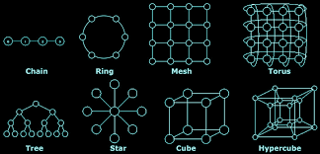
STATIC INTERCONNECTION NETWORKS

Slide 81
Dynamic (Indirect / Multistage) Networks
Connections are established via switches or routers, allowing dynamic paths.

Slide 82
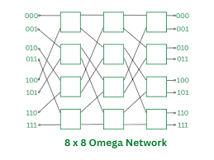
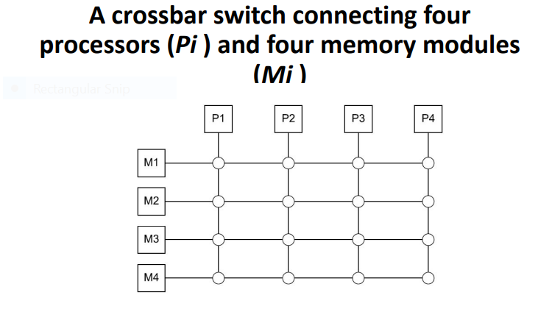
OMEGA AND CROSSBAR

Slide 83
CACHE COHERENCE
Cache coherence is a crucial concept in shared-memory multiprocessor systems (especially MIMD), where each processor has its own local cache but shares the same main memory.
The challenge: how to keep data consistent across all caches when multiple processors access and modify shared variables.
What is Cache Coherence?
Cache coherence ensures that:
All processors see a consistent view of memory.
If one processor updates a memory location, others see the updated value.

Slide 84
Why is Cache Coherence Needed?
Cache coherence is the discipline that ensures data consistency across multiple local caches in a multicore or multiprocessor system.
If one processor modifies a shared memory location, coherence
mechanisms guarantee that all other processors see the updated value
rather than stale data.
Problem:
Suppose processor P1 caches a variable X = 5.
Processor P2 also caches X = 5.
P1 writes X = 10 to its cache.
P2 still sees X = 5 — now memory is incoherent.
This can cause bugs, race conditions, or wrong results in parallel programs.

Slide 85
Snooping Cache Coherence
2 approaches to ensure cache coherence
Snooping cache coherence
Directory based cache coherence
Snooping cache coherence
Snooping" refers to each cache controller monitoring (or snooping) the communication bus for any memory transactions initiated by other processors.
Directory based cache coherence
Directory-based cache coherence is a method used in parallel computing to keep the data stored in the caches of different processors consistent.
A directory (a special table) keeps track of which processors have copies of a particular data item. Whenever a processor changes the data, the directory informs the other processors so that they update or remove their old copies.

Slide 86
Contd..
When a processor reads or writes to memory, all caches 'snoop' on the bus to determine if they have a copy of that memory block, and react accordingly.
Write-Update (Write-Broadcast)
Instead of invalidating, the processor broadcasts the new value to other caches.
All caches update their copies.

Slide 87
Process
A process is an independent program in execution, with its own memory space, resources, and execution context.
Has its own memory (code, data, heap, and stack segments) is managed by the OS scheduler.
More heavyweight than threads.

Slide 88
Threads
A thread is the smallest unit of execution within a process. All threads in a process share the same memory space, but have their own stack and registers.
Shares memory with other threads in the same process.
Faster context switching.
Lightweight compared to processes.
Can communicate easily with other threads (since they share memory)
Useful for parallelism in multi-core systems.

Slide 89
Coordinating the processes/threads
1. Divide the work among the processes/threads in such a way that
a. each process/thread gets roughly the same amount of work, and
b. the amount of communication required is minimized.
2. Arrange for the processes/threads to synchronize.
3. Arrange for communication among the processes/threads.

Slide 90
Contd..
double x [ n ] , y [ n ] ;
for ( i n t i = 0; i < n ; i ++)
x [ i] += y [ i ] ;
To parallelize this, we only need to assign elements of the arrays to the processes/ threads.
For example, if we have p processes/threads,
we might make process/ thread 0 responsible for elements 0, . . . ,
n/p− 1,
process/thread 1 would be responsible for elements n/p, . . . ,2n/p − 1, and so on.

Slide 91
Shared Memory
Shared-memory programs use dynamic threads.
A master thread controls the execution of the program.
Several worker threads perform the assigned tasks.
Whenever a new task arrives, the master thread creates (forks) a worker thread.
The worker thread executes the task.
After the task is completed, the worker thread terminates and joins the master thread.
System resources are used efficiently because threads exist only while they are required.

Slide 92
Static Thread
An alternative to the dynamic paradigm is the static thread paradigm.
The master thread performs the initial setup.
The master thread creates (forks) all worker threads at once.
The worker threads execute their assigned tasks.
The worker threads continue running until all the work is completed.
After the work is finished, all the threads join the master thread.
Finally, the master thread performs cleanup operations, such as releasing memory, and then terminates.

Slide 93
Nondeterminism
Nondeterminism is a situation in which a program produces different outputs even when it is executed multiple times with the same input.
In parallel computing, several threads run simultaneously, and the exact order in which they execute is unpredictable. Because of this, the final result may vary from one execution to another.
Definition
Nondeterminism is the inability to predict the exact order of execution of threads or processes in a parallel program.

Slide 94
As a very simple example, suppose we have two threads, one with ID or rank 0 and the other with ID or rank 1. Suppose also that each is storing a private variable my_x, thread 0’s value for my_x is 7, and thread 1’s is 19.
printf("Thread %d > my_x = %d\n", my_rank , my_x);
Then the output could be
Thread 0 > my_x = 7 Thread 1 > my_x = 19
but it could also be
Thread 1 > my_x = 19 Thread 0 > my_x = 7

Slide 95
Suppose each thread computes an int, which it stores in a private variable my_val.
Suppose also that we want to add the values stored in my_val into a shared-memory location x that has been initialized to 0.
Both threads therefore want to execute code that looks something like this: my_val = Compute_val(my_rank); x += my_val

Slide 96
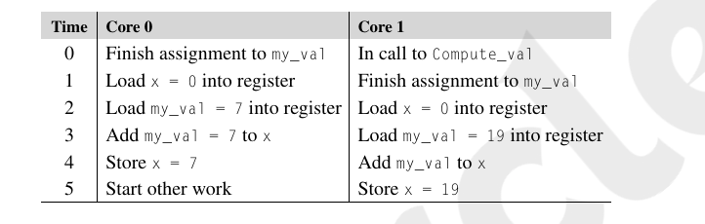

Slide 97
A block of code that can only be executed by one thread at a time is called a critical section
When threads or processes attempt to simultaneously access a shared resource, and the accesses can result in an error, we often say the program has a race condition, because the threads or processes are in a “race” to carry out an operation.

Slide 98

we need to ensure that if one thread is executing the code in the critical section, then the other threads are excluded.
The most commonly used mechanism for ensuring mutual exclusion is a mutual exclusion lock or mutex, or simply lock.
A mutex is a special type of object that has support in the underlying hardware. The basic idea is that each critical section is protected by a lock.

Slide 99
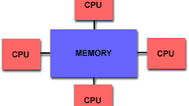
SHARED MEMORY
Shared memory is a memory architecture where multiple processors or threads can access the same memory space.
It is one of the most common models used in parallel computing, especially in multi-core and symmetric multiprocessor (SMP) systems.
What is Shared Memory?
In a shared memory system, all processors share a single global memory.
Each processor has access to the same variables and data structures in memory, which allows easy communication and data sharing.
Fig:Shared memory Archtecture

Slide 100
Types of Shared Memory Systems
Uniform Memory Access (UMA)
All processors access memory with equal latency(The time taken for data to travel from the source to the destination) And Bandwidth(The amount of data that can be transferred in a given period of time)
Simpler hardware.
Example: Traditional SMP systems (symmetric multiprocessor )
UMA - the time to access all the memory locations will be the same for all the cores

Slide 101
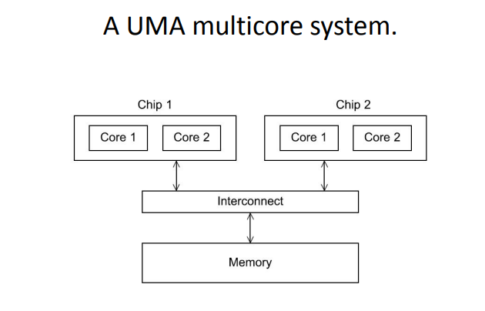
UMA

Slide 102
NUMA
NUMA-
A memory location to which a core is directly connected, can be accessed more quickly than a memory location that must be accessed through another chip.
"NUMA" most commonly refers to Non-Uniform Memory Access, a computer memory design where a processor can access its own local memory faster than memory local to another processor.
It is heavily used in high-performance servers and data centers to optimize processing speeds

Slide 103
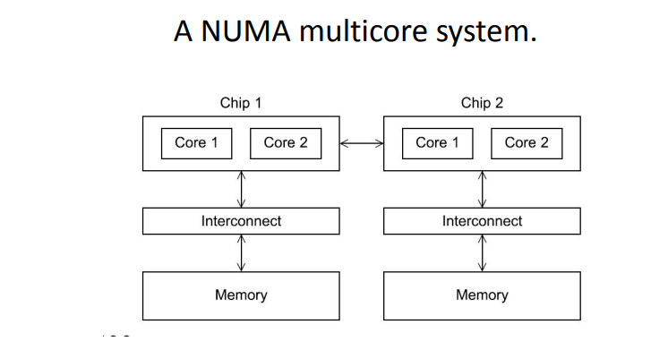
NUMA

Slide 104
Difference between UMA and NUMA
Feature | UMA (Uniform Memory Access) | NUMA (Non-Uniform Memory Access)
Full form | Uniform Memory Access | Non-Uniform Memory Access
Memory access time | Equal for all processors | Different for different processors
Memory organization | Shared memory | Distributed shared memory
Processor access | Every processor accesses memory at the same speed | Access speed depends on the memory location
Performance | Suitable for small systems | Suitable for large systems
Complexity | Simple design | More complex design
Scalability | Limited scalability | Highly scalable
Cost | Less expensive | More expensive

Slide 105
2.DISTRIBUTED MEMORY
Distributed memory is a computer architecture where each processor has its own private memory, and processors communicate explicitly by passing messages.
It's widely used in large-scale parallel systems, such as clusters, supercomputers, and cloud-based architectures.
The most widely available distributed-memory systems are called clusters.
They are composed of a collection of commodity systems—for example, PCs—connected by a commodity interconnection network—for example, Ethernet.
The grid provides the infrastructure necessary to turn large networks of geographically distributed computers into a unified distributed-memory system.

Slide 106
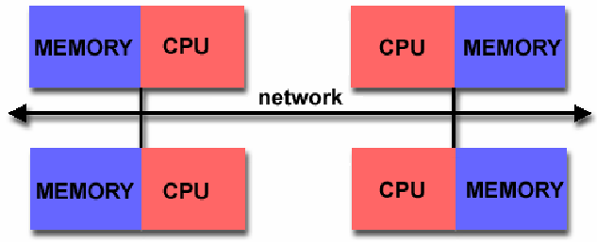
Distributed-memory programs are usually executed by starting multiple processes rather than multiple threads.
This is because typical “Threads of execution” in a distributed-memory program may run on independent CPUs with independent operating systems, and there may be no software infrastructure for starting a single “distributed” process and having that process fork one or more threads on each node of the system.
Fig:Distributed-memory Archtecture

Slide 107
Message-passing
A message-passing API provides (at a minimum) a send and a receive function.
Processes typically identify each other by ranks in the range 0,1,...,p− 1, where p is the number of processes.
So, for example, process 1 might send a message to process 0 with the following pseudocode:

Slide 108
char message[100];//A character array named message is created.It can store up to 100 characters.
my_rank = Get_rank();
if (my_rank == 1) {
sprintf(message, "Greetings from process 1");
Send(message, MSG_CHAR, 100, 0);
}
else if (my_rank == 0) {
Receive(message, MSG_CHAR, 100, 1);
printf("Process 0 > Received: %s\n", message);
} message passing extra.docx

Slide 109
One-sided communication
. One-sided communication is a communication method in which only one process performs the communication operation, while the other process does not actively participate at that moment.
In simple terms:
The sender can directly place data into the receiver's memory.
The receiver does not have to execute a corresponding receive operation.
Why is it called "one-sided"?
Only one process performs the operation.
Process A ─────────► Process B
(Put/Get) (No action required)

Slide 110
Types of one-sided communication
Operation | Description
Put | Writes data into another process's memory.
Get | Reads data from another process's memory.
Accumulate | Updates data in another process's memory.
One-sided communication versus two-sided communication
Feature | One-sided communication | Two-sided communication
Sender participation | Required | Required
Receiver participation | Not required | Required
Synchronization | Less | More
Speed | Faster | Slower
Example | MPI_Put(), MPI_Get() | MPI_Send(), MPI_Receive()

